Slide 1
Okta Mobile Connect Overview Hassen Karaa Sr. Product Manager, Okta Inc.

Slide 2
Okta Mobile Connect Goal
Bring SSO experience, ease of use and security to native mobile apps
Cover ISV, and in house built apps
Support for multiple platforms, configurations, authentication protocols

Slide 3
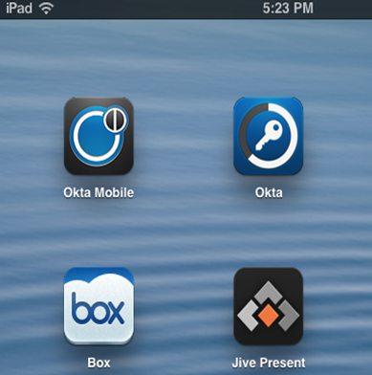



Okta Mobile Connect- User Experience
Install Okta Mobile
Login to Okta Mobile
Launch client app
App switch animation
Client app launches and user is logged in
?
Notes:
----- Meeting Notes (5/28/13 11:04) -----
- Worried about chatter access
- more HTML5 at this point
- Not too worried about token revocation
- Reverse proxy: want to get rid of site minder. Universal workspace. Citrix based front ended with site minder from CA.
- They may not wrap these apps into native interfaces. Okta mobile might be enough.

Slide 4
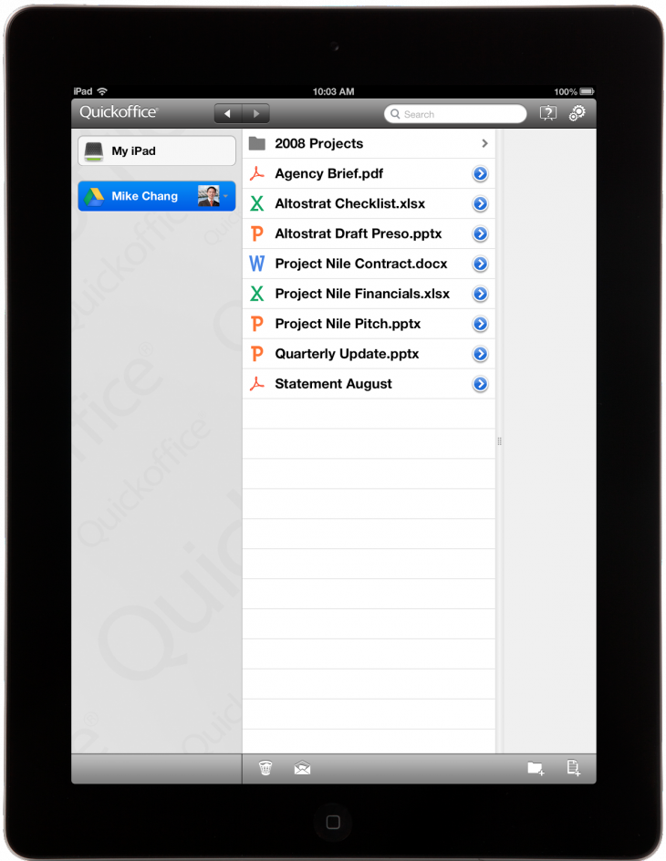


Okta Mobile Connect- User Experience
App
App
App
4
1
2
Okta Mobile App
App Server
3
App makes an authentication request to Okta Mobile using the SSO APIs
Okta Mobile checks authorization for the user against the Okta server
Okta Mobile requests SSO token for the user/app from app server
Okta Mobile passes the SSO token that it receives to the app

Slide 5
Authentication Protocols Support plan
Oauth 2.0 (supported)
OAuth1.0 (coming soon)
Cookies based auth (coming soon)
REST based auth (coming soon)

Slide 6
Developer Experience
The app will need to add the the following support:
Add the Okta URL callback scheme to the supported URL schemes so that the app can communicate with Okta Mobile
Use the Okta SSO client APIs to request and parse the responses
At app launch, check if Okta mobile is installed. If so, show the “Login with SSO” button or automatically initiate SSO
Send an SSO request to Okta Mobile using the URL callback scheme
Receive the SSO token back from Okta Mobile

Slide 7
Developer Experience Cont’d
To onboard an App for mobile SSO, Okta needs the following information:
General Information
Name, description
Bundle id
Services for which app needs SSO (if logging into multiple services)
For Oauth based authentication
Client id and client secret
Supported OAuth version
OAuth endpoint
For cookies based authentication
URLs for which cookies are needed
For REST based authentication
REST endpoint address
https parameters (url params, http headers, authorization type, related info)

